Slide 1





Gentleman: a lightweight web-based projectional editor + Creating a language
Louis-Edouard LAFONTANT

Slide 2


Introduction
Computer science graduate specialized in software engineering
Course instructor at University of Montreal and member of the GEODES Software Engineering Research Group
Strong interest in human-computer interaction (HCI) and the exploitation of dynamic environments.
Current research with prof. Eugene SYRIANI
Domain-specific modeling
Low-code engineering
Projectional editing
Gentleman (collab. with E. SYRIANI)

Slide 3
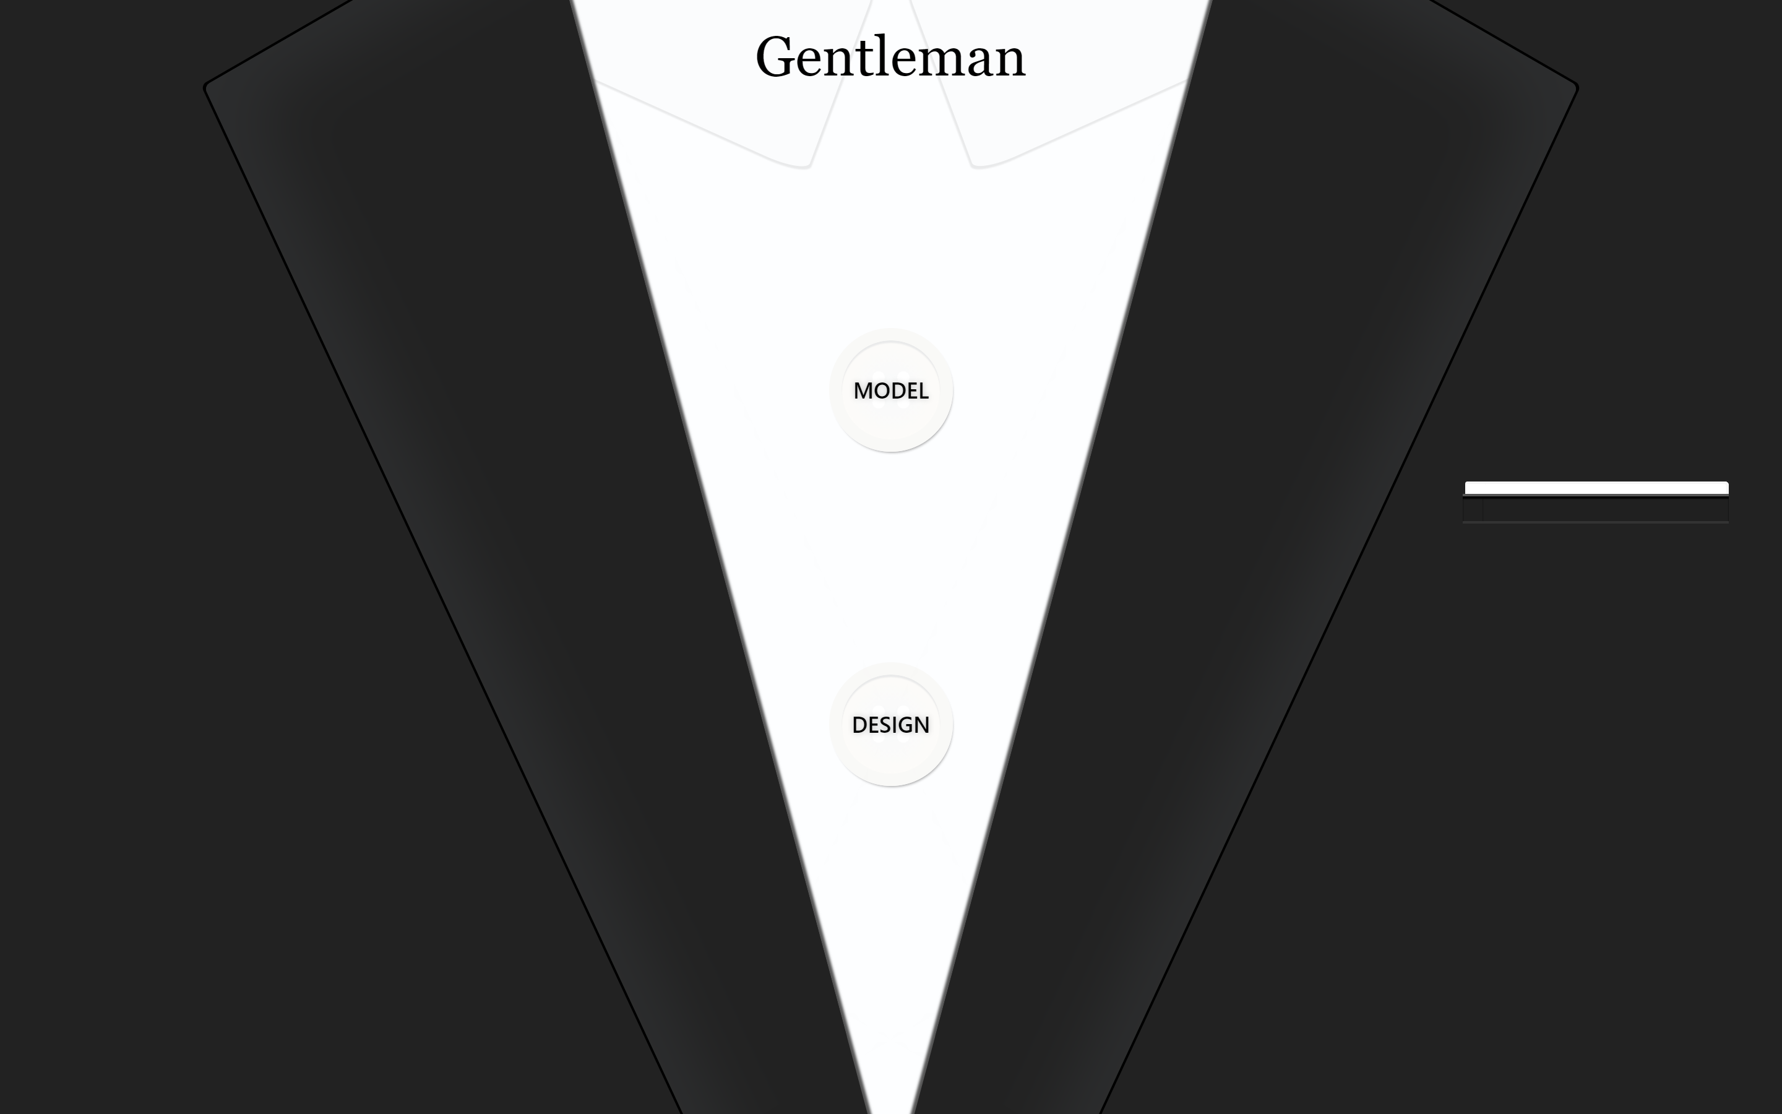
Outline
Background
Gentleman
Demonstration
Outlook
Questions

Slide 4
Domain-specific modeling
Raising the level of abstraction
Solution specified directly using problem domain concepts
Software development as a model-driven activity
Leveraging the expertise and knowledge of many experts instead of relying solely on technical experts
✓ Make software more accessible and inclusive
✓ Better productivity and improved quality
However, the adoption is not as widespread as envisioned. Why?

Slide 5


Language workbench
Tools that support the efficient definition, reuse, and composition of languages and their IDEs.
Editing environments
Parser-based editor (free-form, syntax-directed) Xtext, MetaEdit+, AToMPM
Projectional editor: no-parser, multiple notations MPS, WholePlatform
Recurring problems
Rooted in OOP
Heavy-weight
Platform-specific
Poor usability

Slide 6
How can we improve on the situation?
Define concepts with structures and languages unrelated to any programming code concept (UML, OO)
1
Move MDE/DSM to a user-driven approach, instead of a technology-driven approach
2
Take projectional editing to the web and provide a lightweight solution
3

Slide 7
Gentleman
Goal: Making modeling more accessible to domain experts
Projectional editing
Concept: structure to define the model
Projection: visuals to interact with the model
Features
✓ Lightweight and minimalistic design
✓ Web solution: no installation required
✓ Easy integration
✓ Built with a user-centric approach
✓ Compatible with Ecore model

Slide 8
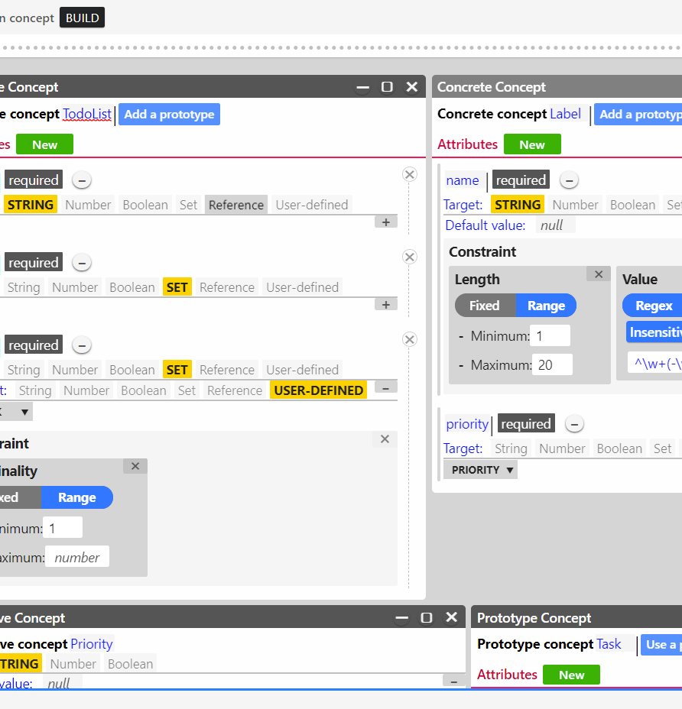
Concept
Encapsulates the concepts used to define a model or metamodel
Types of concept
Primitive: String, Number, Boolean, Set, Reference
Complex: Concrete, Prototype, Derivative
Relations
Attributes (external): extrinsic concept characteristic
Properties (internal): intrinsic concept characteristic

Slide 9
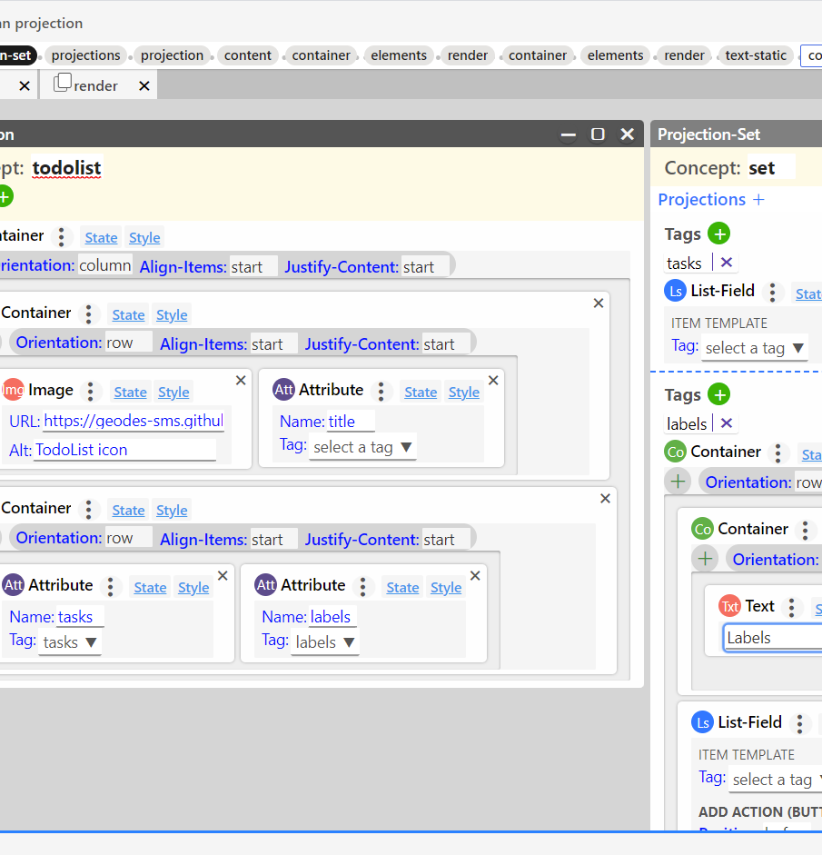
Projection
Representation of a concept that can be visualized and interacted with in the GUI
Common elements found in GUI design
Layout: Flex, Table
Field: Text, Binary, Choice, Link, List
Static: Text, Link, Image, Button
Help users quickly scan and comprehend the model
Leverage web technology
HTML 5 widgets, templates
CSS style and animation

Slide 10
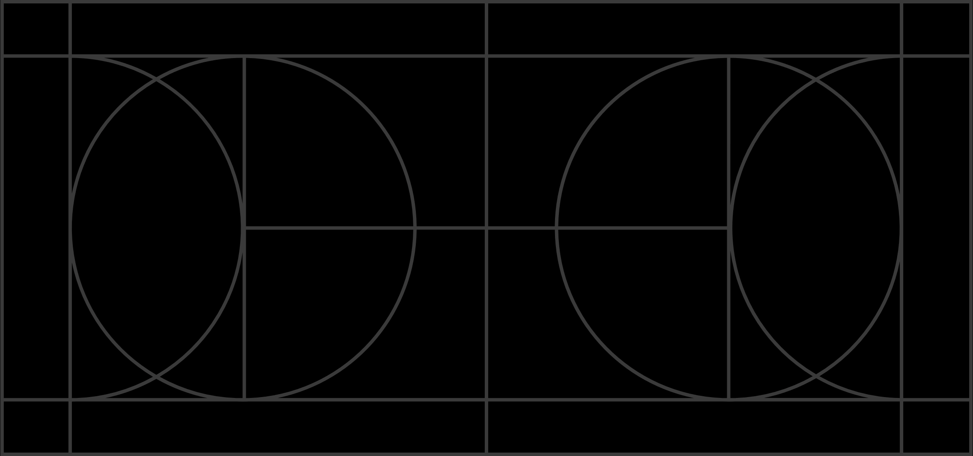
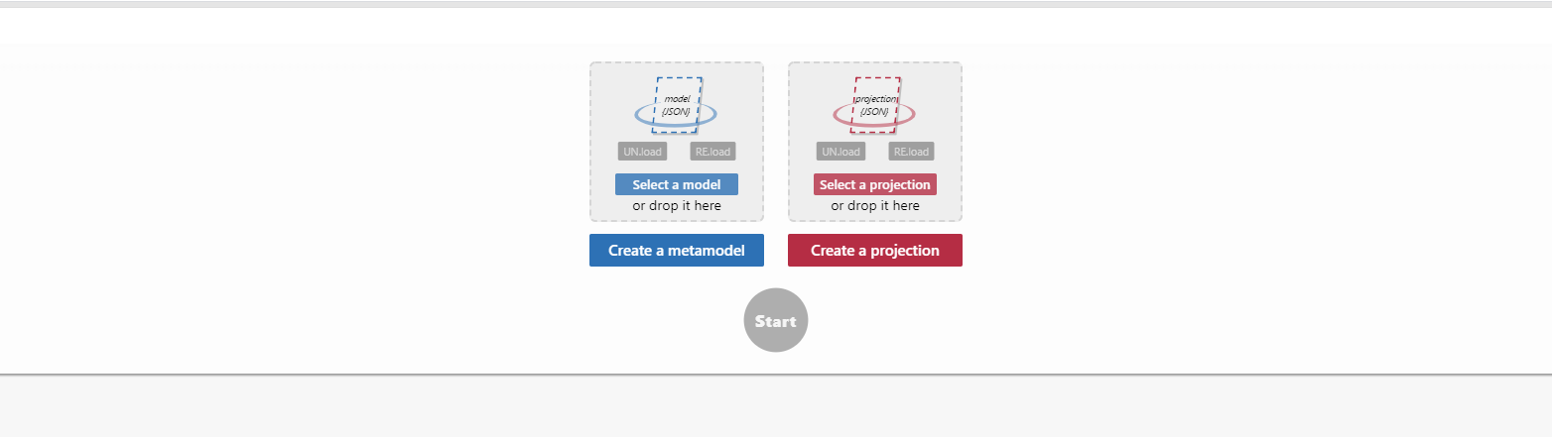
Demonstration
Concept definition
Projection definition
Integration

Slide 11

Outlook
Currently being looked at
Add support for graphical notations
Improve the projection preview experience
Provide more export options
On the horizon
Operations and predicate-based properties
Integration with a modeling server
Repository of concepts

Slide 12

Discussion and Questions
Thank you!

